Slide 1
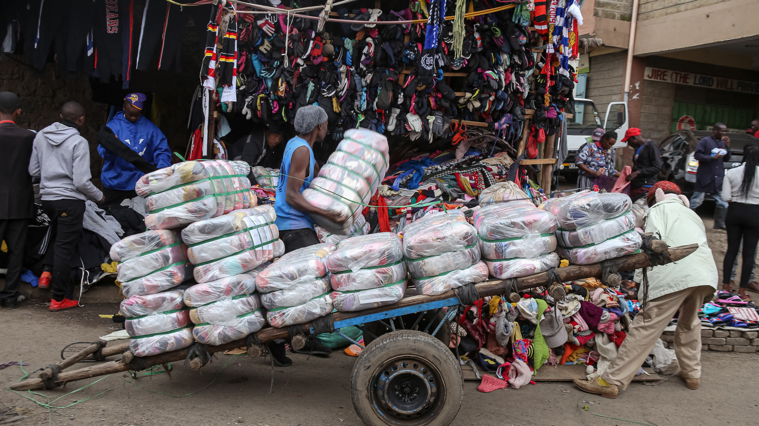
Lesson 5
Fashion and Sustainability
Where are these clothes going?
※本サンプルでは動画は再生されません
Click to play the video.

Slide 2

B. Dialogue Comprehension
What items are they talking about?
2. What will Misa do with the items after talking to her father?
ⓐ She will try to sell them.
ⓑ She will make them into something else.
ⓒ She will give them to her relatives.
ⓓ She will throw them away with her cousin.

Slide 3
B. Dialogue [Answers]
What items are they talking about?
2. What will Misa do with the items after talking to her father?
ⓐ She will try to sell them.
ⓑ She will make them into something else.
ⓒ She will give them to her relatives.
ⓓ She will throw them away with her cousin.

Slide 4
B. Dialogue [Script]
Father: | Wait, wait! What are you doing with those clothes?
Misa: | I’m going to throw them away.
Father: | Throw them away? But there’s nothing wrong with them. Why do you want to throw them away?
Misa: | They are out of fashion. And besides, my closet is full.
Father: | Why don’t you give them to your cousin? I hear she isn’t interested in fashion like you. She wouldn’t mind wearing clothes that are “out of fashion.”
Misa: | I have already asked her mother.
Father: | You did? So what did she say?
Misa: | She says their closets are full, too.
Father: | Oh well. There must be someone who needs them. Maybe you could donate them to a charity group or something.
Misa: | Mmm... I don’t know. I could check out that second-hand store near the bus stop. They have put up a sign saying, “We will buy anything.”
Father: | Good idea. It’s much better than just throwing them away.

Slide 5
New Words [Scene 1]
desire
欲望

Slide 6
New Words [Scene 1]
clothing
衣料品，衣類

Slide 7
New Words [Scene 1]
worrying
気がかりな

Slide 8
New Words [Scene 1]
landfill
埋め立て地

Slide 9
New Words [Scene 1]
current
現在の

Slide 10
How many times do you wear your clothes before you think they are old? One study found, in the case of the average woman, it is 7 times!
1
2

Slide 11
あなたは自分の服を何回着たらそれらを古いと思うだろうか？ ある研究では，平均的な女性の場合，それは7回であることがわかった。

Slide 12
Our desire for new clothes leads clothing companies to produce more. Over 100 billion pieces of clothing are made in the world every year. That is twice as many as in the year 2000.
3
4
5

Slide 13
私たちの新しい服への欲望が，衣料品会社により多く生産させる。世界では毎年1,000億枚以上の衣類が作られる。その数は2000年の2倍である。

Slide 14
TRY 2
N
M
N

Slide 15
TRY 3
Choose one correct statement for each scene.
Scene 1
ⓐ The average woman wears clothes for 7 months.
ⓑ The amount of clothes produced today is half of that in 2000.
ⓒ We keep our clothes twice as long as before.
ⓓ Most of our clothes go to landfills or are burned each year.

Slide 16
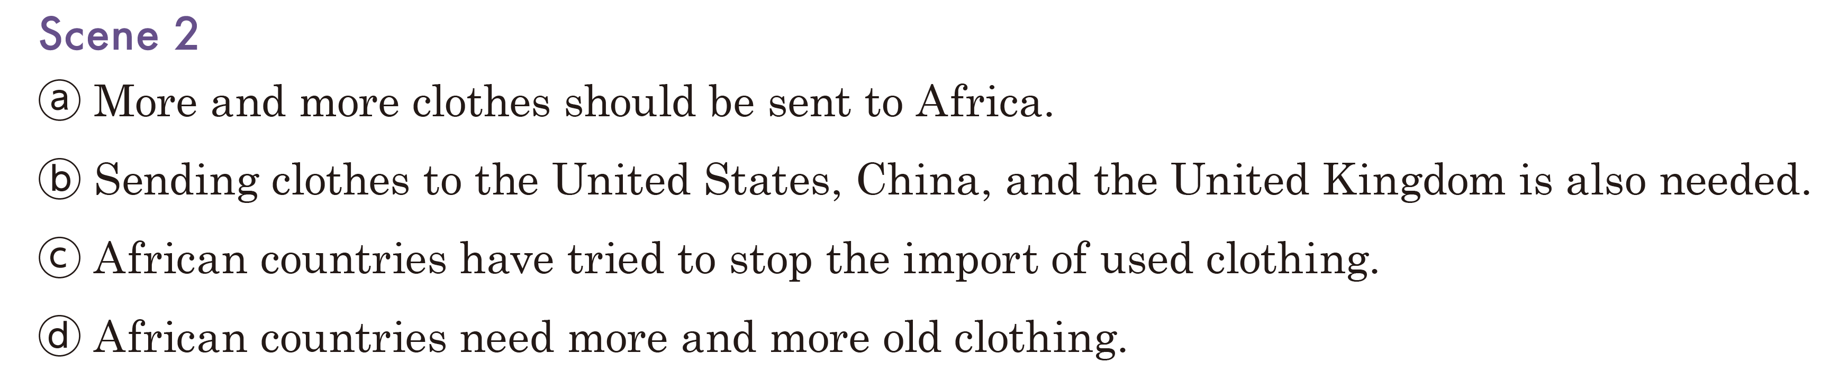
TRY 3

Slide 17
TRY 3

Slide 18
TRY 3

Slide 19
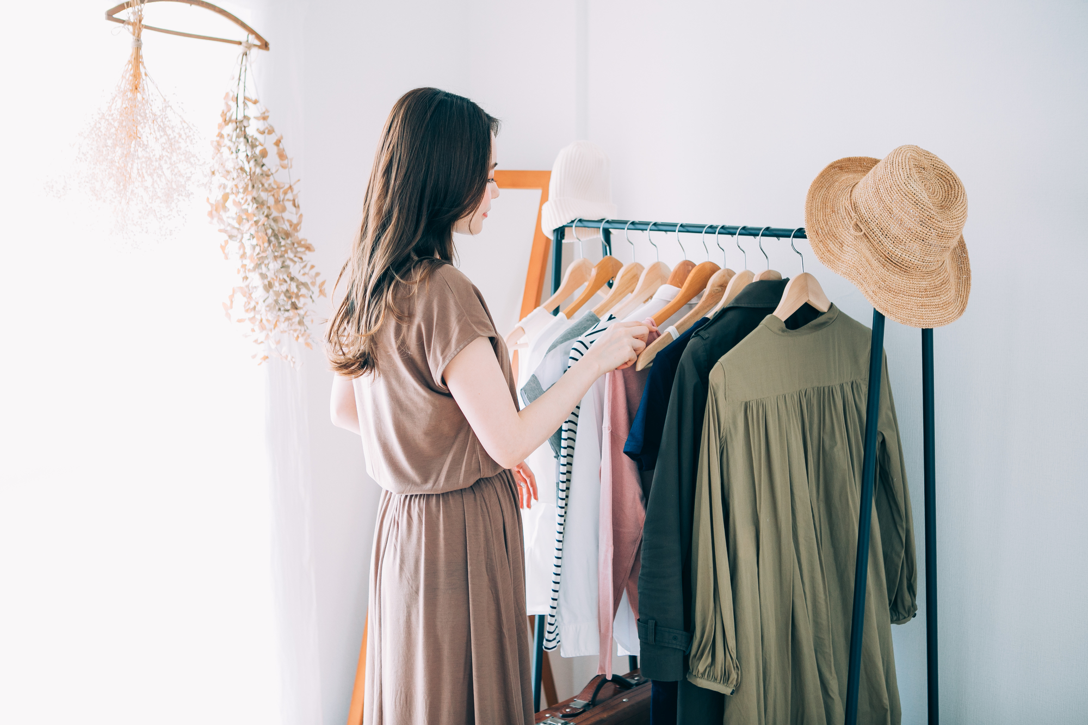
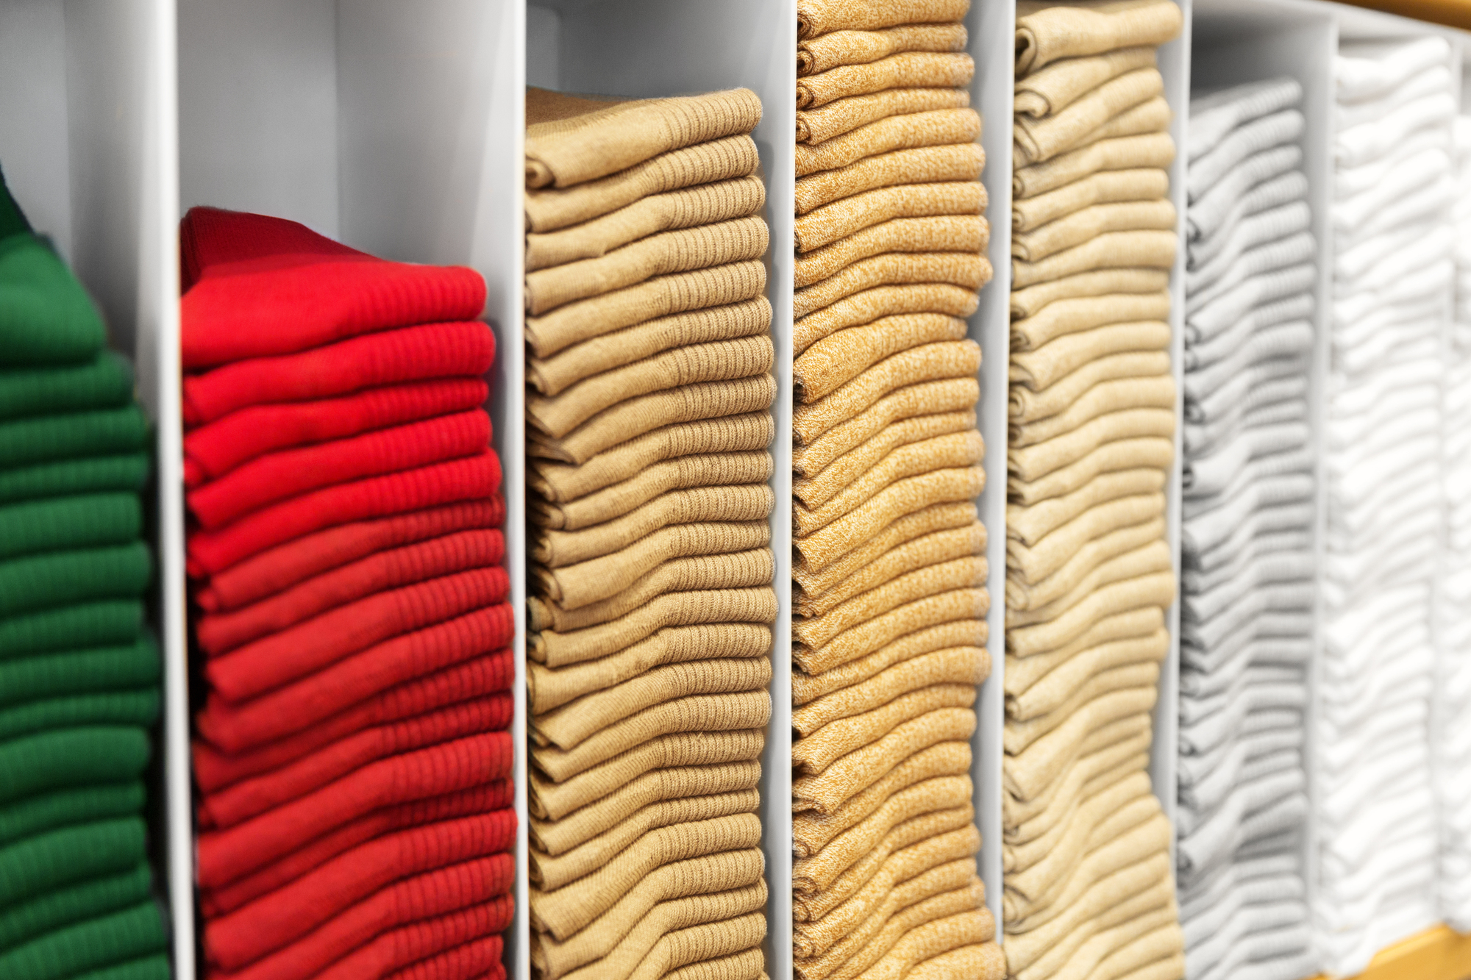
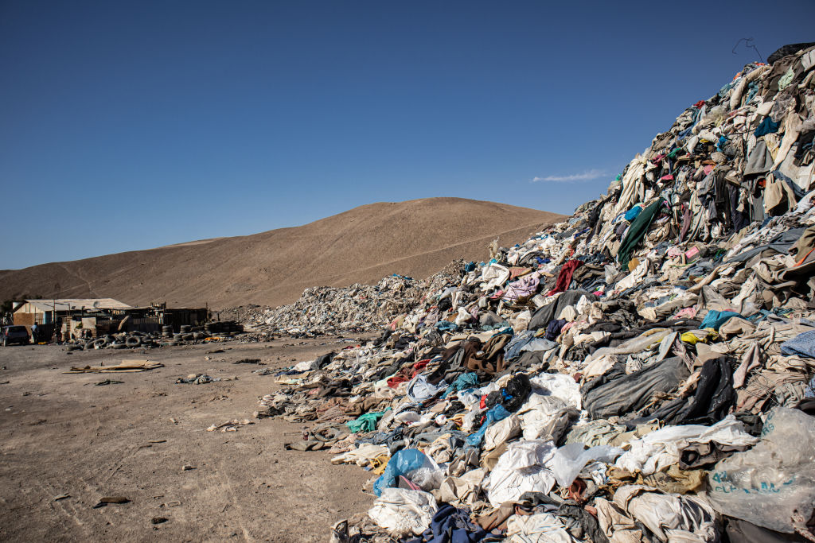
TRY 5 Retelling
without keywords
Notes:
[Retelling例]
ここにRetellingの解答例を入れる。

Slide 20
TRY 5 Retelling
with keywords
the average woman / 7 times / over 100 billion
85% / landfills / burn / by 2030 / 102 million tons
7% to 12% / methane
Notes:
[Retelling例]
ここにRetellingの解答例を入れる。

Slide 21
TRY 5 Retelling
answering questions
How many times does the average woman wear her clothes before she thinks they are old?
How many pieces of clothing are made in the world every year?
How much of the world’s landfills are made up of used clothing? What’s the problem with that waste?
Notes:
[Retelling例]
ここにRetellingの解答例を入れる。

Slide 22
TRY 5 Retelling
fill in the blanks
(Over 100 billion) of clothing are made in the world every year, and this is (twice) as many as in the year 2000.
(85%) of these clothes are (thrown away in landfills) or burned. The amount of clothes we buy might increase to (102 million tons).
When the waste break down (methane) is released, which is 25 times (worse for global warming) than CO₂.

Slide 23
TRY 5 Retelling
fill in the blanks
(Over 100 billion) of clothing are made in the world every year, and this is (twice) as many as in the year 2000.
(85%) of these clothes are (thrown away in landfills) or burned. The amount of clothes we buy might increase to (102 million tons).
When the waste break down (methane) is released, which is 25 times (worse for global warming) than CO₂.

